Slide 1
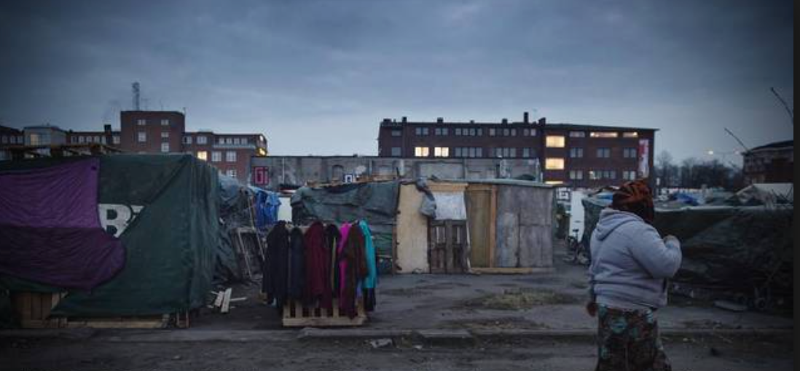
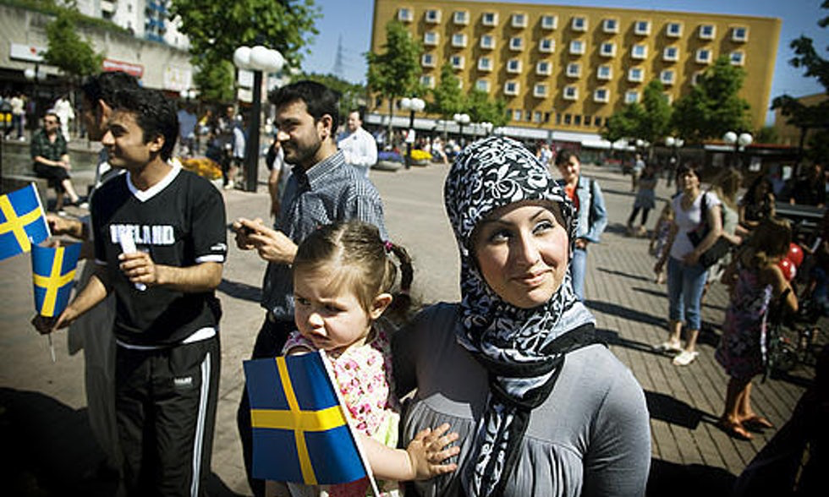
TB and HIV screening among migrants
-qualitative studies from Stockholm, Sweden
Anna Mia Ekström
Professor, MD, MPH, PhD
Karolinska University Hospital & Karolinska Institutet, Sweden
anna.mia.ekstrom@ki.se
Nothing to disclose
Photo David Magnusson/SCANPIX
Notes:
Migrant’s perspective on TB and HIV: A qualitative study in Stockholm, Sweden

Slide 2
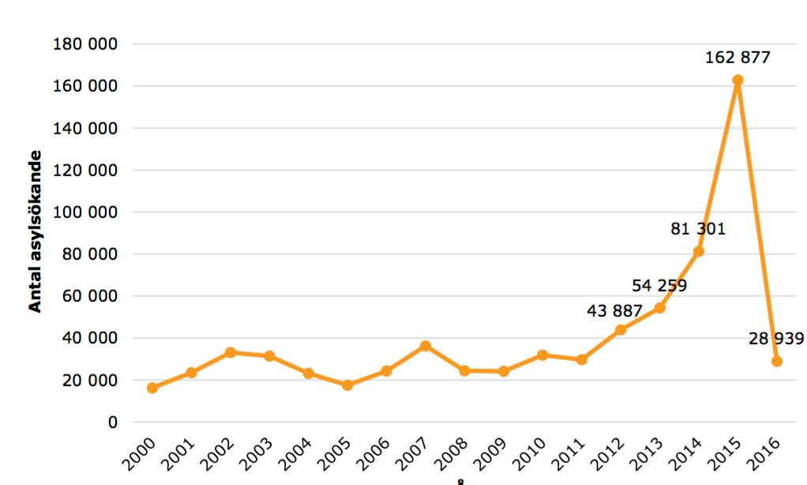
Migrants in Sweden
Swedish population: 10 million
Foreign-born
  1.9 million (18.5%)
  3 million (31% at least on parent born abroad)
Asylum seekers
  Peaked in 2015
  30% women/70% men
  >40% children, 20% unaccompanied
  Majority Syria, Iraq, Somalia, Eritrea, Afghanistan
  20-30% poor mental health (anxiety, PTSD, depression)
  History of sexual abuse/use
Hot political issue, nationalism/racism
Notes:
Migrants in all of Sweden have different entitlements to healthcare according to their age and legal status
There were 25,000 asylum seekers in Sweden during 2017; 10,000 were women, 15,000 were men.
Reference - (https://www.migrationsverket.se/download/18.4a5a58d51602d141cf41003/1515076326490/Asyls%C3%B6kande%20till%20Sverige%202000-2017.pdf)
(12%) HIV: Reference - http://www.vardgivarguiden.se/globalassets/behandlingsstod/smittskydd/statistik/hiv/2017.pdf
(9%) TB: Reference - http://www.vardgivarguiden.se/globalassets/behandlingsstod/smittskydd/statistik/tuberkulos/2017.pdf
Totalt diagnosticerades 11 av 126 patienter i 2017
The proportion of asylum seekers who recived a health examination nearly doubled in the period of 2015-2016
http://dok.slso.sll.se/CES/FHG/Folkhalsoarbete/Rapporter/halsoundersokningar-for-asylsokande-och-nyanlanda.pdf
Reference - https://skl.se/download/18.18efb8dc15a60e54b23a68f9/1488290534341/halsa-i-sverige-for-asylsokande-och-nyanlanda.pdf
(18 April 2018)
Under 2015 ansökte fler ensamkommande barn än någonsin asyl i Sverige. Sedan årsskiftet 2015/2016 har dock antalet minskat kraftigt, framförallt beroende på de inre gränskontrollerna mellan Danmark och Sverige och EUs migrationsöverenskommelse med Turkiet. När barn och ungdomar under 18 år kommer ensamma till Sverige och söker asyl skyddas de av FN:s konvention för barns rättigheter. De behandlas också särskilt i relation till Dublinförordningen.
2017 ansökte 1 336 ensamkommande barn om asyl och 2016 ansökte 2 199 ¹ Det är att jämföra med 35 369 ensamkommande barn som sökte asyl 2015.² Av de ensamkommande barn som sökte asyl 2017 var 222 från Afghanistan, året innan var nästan en tredjedel från Afghanistan (665 personer). Den näst största gruppen 2017 om 159 barn kom från Somalia, följt av Syrien, Eritrea, Irak och Marocko. De allra flesta är pojkar (1 043) mellan 13-17 år. Antalet flickor var för motsvarande åldersspann var 293.³
Av det totala antalet asylsökande 2017 var dryga 5 procent ensamkommande barn och ungdomar, jämfört med 7 procent 2016, 22 procent 2015 och 8 procent 2014.⁴ ⁵

Slide 3
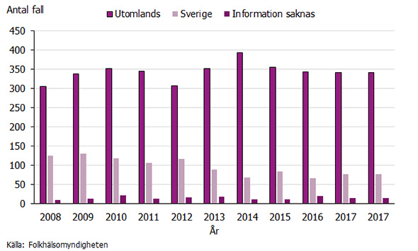
HIV and TB among migrants in Sweden
HIV
  HIV% extremely low <0.001%
  >80% of new HIV infections acquired before arrival to Sweden
  Only 12% of new HIV cases identified through migrant screening
  Most with HIV late testers
  x2 risk also of acquiring HIV in Sweden
TUBERCULOSIS
  >80% of new TB diagnoses are in migrants
  TB 50 x more common migrants
  9% of asylum seekers diagnosed with TB
New HIV infections, acquired abroad
Notes:
Migrants in all of Sweden have different entitlements to healthcare according to their age and legal status
There were 25,000 asylum seekers in Sweden during 2017; 10,000 were women, 15,000 were men.
Reference - (https://www.migrationsverket.se/download/18.4a5a58d51602d141cf41003/1515076326490/Asyls%C3%B6kande%20till%20Sverige%202000-2017.pdf)
(12%) HIV: Reference - http://www.vardgivarguiden.se/globalassets/behandlingsstod/smittskydd/statistik/hiv/2017.pdf
(9%) TB: Reference - http://www.vardgivarguiden.se/globalassets/behandlingsstod/smittskydd/statistik/tuberkulos/2017.pdf
Totalt diagnosticerades 11 av 126 patienter i 2017
The proportion of asylum seekers who recived a health examination nearly doubled in the period of 2015-2016
Reference - https://skl.se/download/18.18efb8dc15a60e54b23a68f9/1488290534341/halsa-i-sverige-for-asylsokande-och-nyanlanda.pdf
(18 April 2018)
Under 2015 ansökte fler ensamkommande barn än någonsin asyl i Sverige. Sedan årsskiftet 2015/2016 har dock antalet minskat kraftigt, framförallt beroende på de inre gränskontrollerna mellan Danmark och Sverige och EUs migrationsöverenskommelse med Turkiet. När barn och ungdomar under 18 år kommer ensamma till Sverige och söker asyl skyddas de av FN:s konvention för barns rättigheter. De behandlas också särskilt i relation till Dublinförordningen.
2017 ansökte 1 336 ensamkommande barn om asyl och 2016 ansökte 2 199 ¹ Det är att jämföra med 35 369 ensamkommande barn som sökte asyl 2015.² Av de ensamkommande barn som sökte asyl 2017 var 222 från Afghanistan, året innan var nästan en tredjedel från Afghanistan (665 personer). Den näst största gruppen 2017 om 159 barn kom från Somalia, följt av Syrien, Eritrea, Irak och Marocko. De allra flesta är pojkar (1 043) mellan 13-17 år. Antalet flickor var för motsvarande åldersspann var 293.³
Av det totala antalet asylsökande 2017 var dryga 5 procent ensamkommande barn och ungdomar, jämfört med 7 procent 2016, 22 procent 2015 och 8 procent 2014.⁴ ⁵

Slide 4
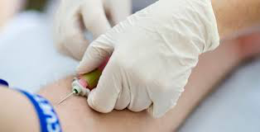
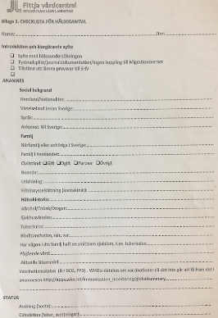
Health examination for asylum seekers
Free voluntary, primarily to identify infectious diseases
    HIV testing offered to all, TB testing endemic countries
Adult asylum seekers entitled to ”care that cannot be postponed” (children full rights to care)
  TB/HIV care, ANC, abortion, contraception counselling
Low uptake of health screening
  39% of asylum seekers received a health examination in 2015 (29% in Stockholm)
  Up to 77% in 2016
  Very low attendance in children (0-15 yrs): 11-33%
TB or HIV-infection, poor mental health… not sufficient reasons for residence permit
Half of those denied asylum go into hiding
*http://dok.slso.sll.se/CES/FHG/Folkhalsoarbete/Rapporter/halsoundersokningar-for-asylsokande-och-nyanlanda.pdf
Notes:
All children under the age of 18 are entitled to full access to healthcare services. However, the rights of adults to healtcare differ according to their legal status, and with asylum seekers having the most restricted rights confined to ”care that cannot be postponed”
A voluntary (free) health examination PURPOSE: To identify health problems that need immediate attention (for the individual person); To detect and prevent spread of infectious diseases (for public health reasons)
Anyone seeking asylum in Sweden can go to one of the 6 centres for a health examination
- Questions regarding the last time the person was tested for HIV or other sexually transmitted infections; as well as a mental health assessment are being discussed to include in the current health examination
Reference - http://slso.sll.se/aktuellt/halsoundersokning-for-flyktingar/
Smittskydd Stockholm har tagit fram rekommendationer för infektionssjukdomar att överväga vid provtagning av asylsökande och nyanlända, både med och utan symptom. HIV och hepatit B tester rekommenderas att tas på alla, hepatit C på personer från högendemiska områden (prevalens ≥ 3 %), latent/aktiv tuberkulos på personer från högriskländer (TBC incidens >100/100 000). Test för Rubella tas på kvinnor mellan 15–45 år som tidigare inte vaccinerats med MPR-vaccin (Mässling-Påssjuka-Röda hund). Barn i förskoleåldern testas för cystor/ mask-ägg.

Slide 5
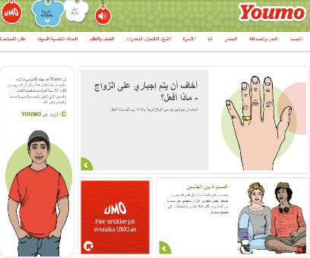
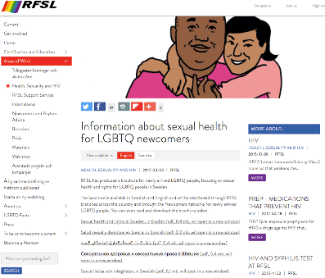
SRHR information and services for new migrants not always tailored to subgroup needs
YOUMO (2017) - Guidance on health, sexuality and gender equality for new migrants aged 13-17
RFSL (2017) – Brochure for newly arrived migrants (LGBTQ people)
Notes:
What SRHR information is available in Sweden for newly arrived migrants?
YOUMO is a website (for young people between 13-20 years old) with information about sex, health, relationships and rights in Sweden
Available in serveral languages: Arabic, Dari, Somali, Swedish, Tigrinish, and English
RFSL is an organization in Sweden and has a brochure for newly arrived (LGBTQ) migrants that focuses on SRHR in Sweden.
Available in Swedish, English, Spanish, Arabic and Russian

Slide 6
Qualitative research on barriers and facilititators of uptake of health examination, TB -and HIV testing
Interviews with actors, providers, clients
Actors (authority representatives migration, public health, community leaders etc) 17 key informant interviews (KII)
Health Providers (26, FGD+ KII) (nurses, nurse aids, administrators, doctors, midwives, psychologists...)
Asylum seekers 18 in-depth interviews (IDI) to explore experiences and perspectives of TB testing
2 parts: health examination vs perceptions of HIV/TB testing
30-60 minutes (providers), 15-30 mins (asylum seekers),
Thematic content analysis

Slide 7
Actors views on health examination, HIV & TB screening among new migrants
Positive aspects
  Good opportunity for early diagnosis and treatment
  Opportunity to introduce migrants to the Swedish health system
  Divided views on mandatory vs voluntary
Challenges/areas for improvement
  Large variation in uptake across the country/municipalities
  Quality control & Guidelines could be improved
  Feedback on impact on infectious disese control lacking
  Family migrants (children <7 yrs, spouse often missed)
  Majority in private housing: never found/called
  Poor coordination in health systems between actors
  Referrals often missed
  Follow-up on tests results and sensitive issues (SRHR, violence, mental health etc) wanted

Slide 8
Health providers on health examination, TB & HIV screening among new migrants
Feeling of doing something meaningful, learning from client histories
Invitation letters now automatically translated, an improvement
Long lagtime between arrival and health examination
Poor uptake due to structural weaknesses, high staff turnover, lack of updated contact details, majority in own /private housing in Stockholm
Wrong expectations from patients (complete physical checkup not done)
Too little time to…
  gain trust to discuss sensitive issues (and other family members in the room)
  follow up on mental health, tests results and sensitive issues (SRHR, violence, mental health etc)
  inform about body/medicine in general
Hard to find female interpretors
Notes:
Preliminary data from the healthcare provider interviews: these are the main messages from the key informants
Few asylum seeker undergo the HE on arrival to Sweden (mainly due to structural weaknesses such as high healthcare staff turnover)
All asylum seekers/newly arrived that do go to the HE are screened for HIV (this is performed by the healthcare providers)
The healthcare providers expressed importance to gain trust in order to discuss sensitive issues, but that this is generally difficult due to the limited time of the HE (45 minutes max), as well as when there are several family members in the same HE session
The healthcare providers suggest to incorporate a secondary HE meeting about a month later if possible to follow-up with the migrants on all general aspects
The healthcare providers also mentioned that the treatments for diseases, including HIV may vary depending on their asylum status

Slide 9
Asylum seekers’ views on health examination
HIV & TB screening
Theme | Positive aspects | Challenges
Availability | Available for primary asylumseeker (but family members often missed) Voluntary | Invitation delayed several months Sent to old address Unclear purpose Thought it was mandatory
Accessibility | Physical access facilitated by mobile clinic Affordable participation | Communication gaps along the way Illiterate or can’t read Swedish Needed others to read/translate letters Hard to find/get to clinic Fear of authorities barrier for uptake
Acceptability and Quality | Feelings of respect and trust Friendly staff Important (should be mandatory) | Not an individual-centred process Mental health & dental care not included Physical examination missing Fear that pos TB or HIV test may impact chance of asylum negatively Needs go beyond infectious disease screening
Notes:
Themes from the interviews:
Availability – Health examination invitations had been received by all participants expect one person; and one person received the invitation but did not participate mainly due to time contraints.
Accessibility – translate the invitation letter; some participants said they went to the health examination with the idea that it is mandatory, while others knew it was voluntary.
Acceptability and Quality - (Perceptions) General dissatisfaction with the content of the health examination

Slide 10
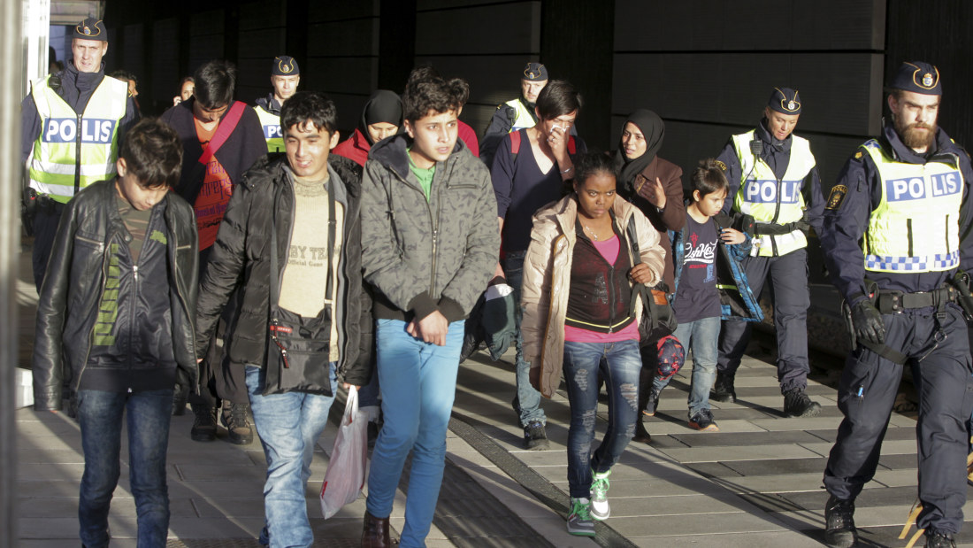
Conclusions & Way forward
Health examination good opportunity for
  early detection of infections, HIV & TB
  introduction to Swedish health system
Biggest problem is low uptake & coverage
  lack of interest/fear
  unclear purpose
  structural challenges to find and invite migrants in particular family members and children
Pupose of health examinations must be clarified to become meaningful and cost-effective, today most HIV and TB cases are missed until symptomatic
Clarify purpose, improve communication channels, skills/competence training of staff, more information already at arrival
More clarity needed on asylum seekers’ rights to mental health care & support
Future research needed on what type of prevention, care and support services that various subgroups of migrants want and need, relating this to social norms
Notes:
. Slutsatser
Hälsoundersökningen erbjuder en möjlighet till provtagning för smittsamma sjukdomar, identifiering av psykisk ohälsa och andra hälso- och sjukvårdsbehov, hälsofrämjande insatser, samt information till asylsökande och nyanlända om det svenska sjukvårdssystemet. En missad HU kan eventuellt få konsekvenser såväl för den enskilde som för samhället. Särskilt när det gäller smittskydd kan en försenad eller utebliven HU eventuellt innebära en samhällsrisk.
Problemet med låg täckningsgrad har diskuterats under en längre tid. Våra preliminära analyser tyder på att det främsta problemet är att nå ut med relevant information om HU till asylsökande. Från tillgänglig data förefaller inte bristande motivation bland asylsökande vara det stora problemet för att nå optimal täckningsgrad. De preliminära analyserna tyder på att personer från de länder som bidrar med flest asylsökande (Afghanistan, Syrien och Irak) i regel kommer till HU när de kallas. Även om andelen som kommer till HU är mycket låg bland asylsökande från vissa andra länder förefaller det som att de största grupperna i hög utsträckning är villiga att genomgå HU. Det har diskuterats huruvida HU bör vara frivilliga eller obligatoriska [41]. Det verkar emellertid vara viktigare att utveckla effektiva informationskanaler än att införa ett obligatorium. I det avslutande avsnittet nedan ger vi förslag på sådana åtgärder.
Att sträva efter hög täckningsgrad är endast relevant om HU svarar mot ett reellt behov, om de har relevant innehåll och erbjuder effektiva åtgärder vid behov. Huruvida HU i dess nuvarande form är en välfungerande plattform för effektiva och kostnadseffektiva preventiva och hälsofrämjande interventioner är oklart. Även samhällsnyttan av systematisk screening för smittsamma sjukdomar har ifrågasatts [31,42]. Hälsobehoven och hälsoundersökningarnas innehåll behöver kartläggas bättre och effekter och kostnadseffektiviteten behöver utvärderas vetenskapligt.
Det råder ingen tvekan om att psykisk ohälsa är ett stort problem bland asylsökande. Det verkar finnas behov av ytterligare standardisering av HU och ytterligare utbildning av berörd vårdpersonal i detta avseende. Detta har tidigare noterats och SKL med flera har tagit fram utbildningsmaterial och arbetssätt. Men det är oklart om HU är den bästa plattformen för att identifiera och åtgärda psykisk ohälsa.
En övergripande utmaning för handläggning av såväl psykisk som somatisk ohälsa är att det råder oklarhet om vilken vård som kan erbjudas inom ramen för ”vård som inte kan anstå”. Tydligare riktlinjer och uppföljning av viken vård som i praktiken erbjuds behövs. En jämlik vårdtillgång behöver säkerställas, åtminstone inom gruppen asylsökande.

Slide 11
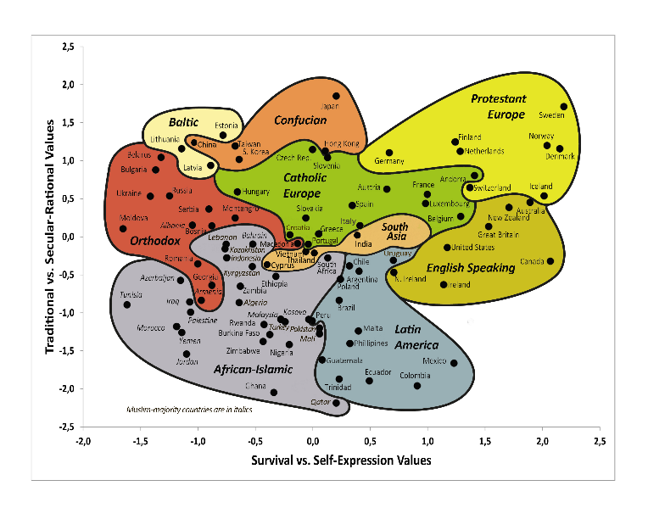
Sweden an “extremist” country in terms of social norms on emancipation, trust in authorities, religion, HBTQ & gender equality
Cultural Map http://www.worldvaluessurvey.org/

Slide 12

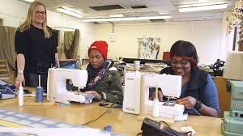
New large survey planned on migrant social norms, needs for information & health services (SRHR, HIV, TB & mental health) being conducted this fall. Stay tuned…!

Slide 13
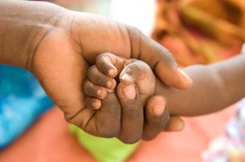
Acknowledgements: Asli Kulane, Knut Lönnroth, Veronika Tirado, Jad Shedrawy, Cecilia Magnusson
Financial support: Stockholm County Council, Swedish Public Health Agency, Forte
https://ki.se/en/phs/global-and-sexual-health
Email: anna.mia.ekstrom@ki.se
Twitter:@EkstromMia
Facebook:https://www.facebook.com/GloSHKI/

